Slide 1
Capstone Project
Sporting Event System
Primary Service: Match Service
www.collaberadigital.com

Slide 2
Profile Details
Past Experience : 2 years as full-stack development experience with projects across various domains, Utility Company, Super Markets. Also, work with one of the largest super market in US as automation and support engineer for 2 years and
Qualification : Bachelor of Science in Information Technology
Career Summary : Full Stack Developer : July 2021 – Present Automation and Support Engineer : May 2019 – July 2021 Technology Stack: ● UI Technologies: jQuery, Angular ● Back-end Technologies: Java, SpringBoot, Unix (C) ● Database: SQL, MySQL, Azure, Postgres, AWS

Slide 3
Capstone Project: Sporting Event System
Sporting Events System allows administrators to manage various sporting events such as the Olympics or Football world cup. This application stores details of teams, players, tournaments and matches, fields and tickets
Business Requirement:
Login and authentication.
Saving details of players, tournaments, matches, fields, players and tickets.
Viewing, updating and deleting the details of players, tournaments, matches,
fields, players.
Updating the ticket details.
Search for tournaments, matches, and payer details and display them.
New administrators to register
Application Quality Requirement:
Rectifying all code smells
Test coverage at least 90% for the primary service (Match Service) and 70% for other services

Slide 4
Capstone Project: Sporting Event System
Primary Service: Match Service
Implement microservices as the application structure. The primary service will be Match service.
The system should enables System administrator to :
Manage sport events such as Olympics or International and local tournaments.
Create and manage sport event details including tournaments, matches, tickets, players, teams and, field.
Implement application structure:
Microservices Architecture
Spring Cloud and Spring Boot REST API.

Slide 5

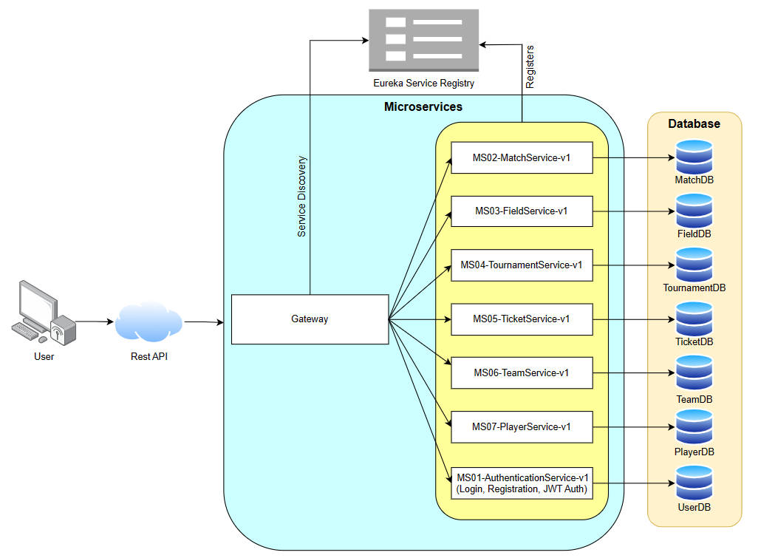

Application Architecture
www.collaberadigital.com

Slide 6
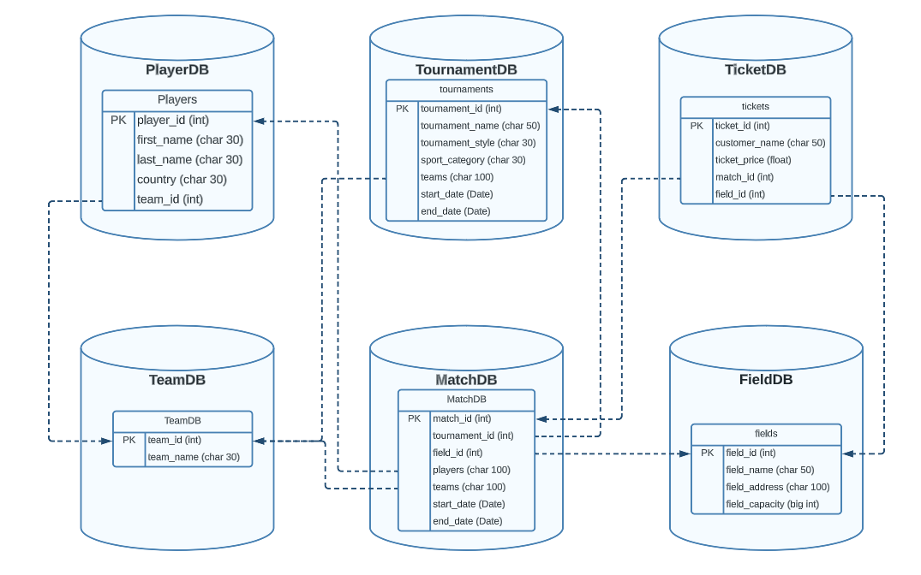
Database Design
www.collaberadigital.com

Slide 7
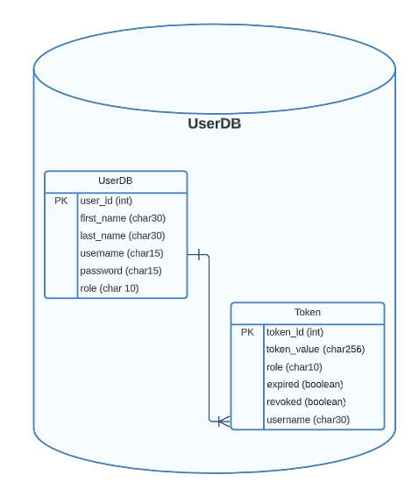
User DB Design – Authentication DB
www.collaberadigital.com

Slide 8
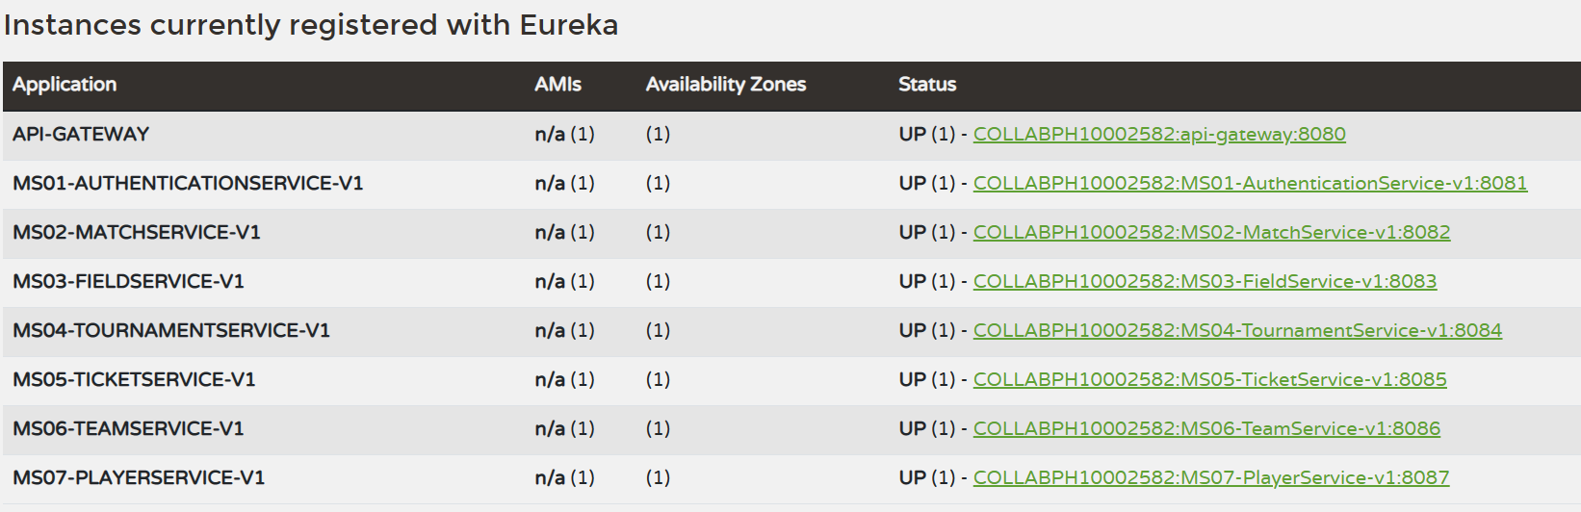
Project - Eureka Dashboard
www.collaberadigital.com

Slide 9
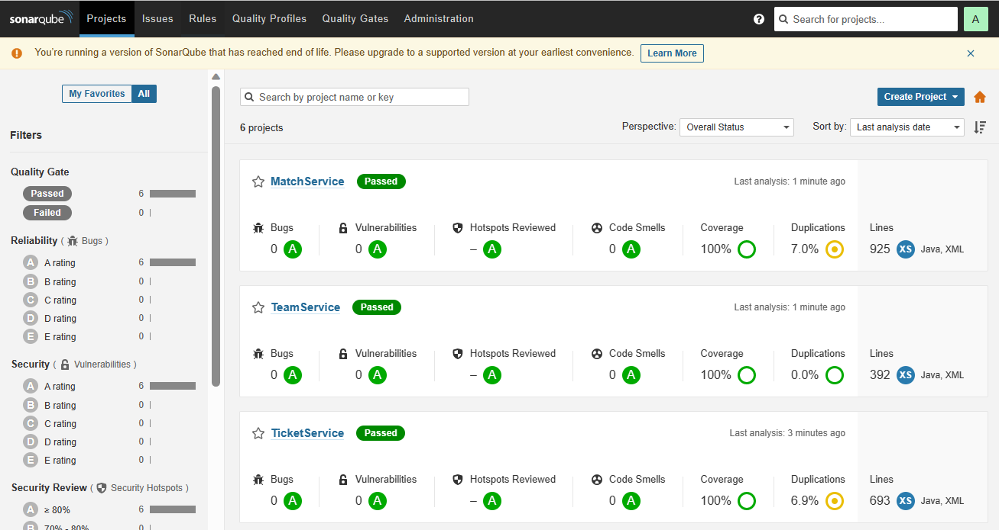
SonarQube Dashboard
www.collaberadigital.com

Slide 10
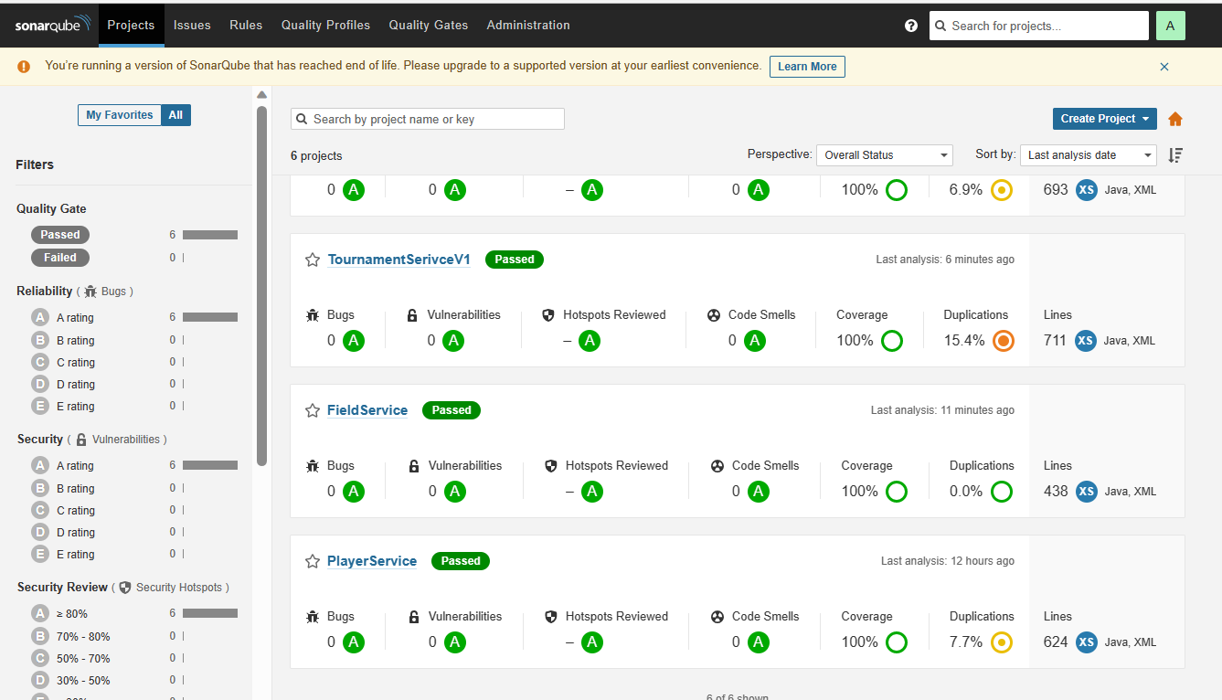
SonarQube Dashboard
www.collaberadigital.com

Slide 11
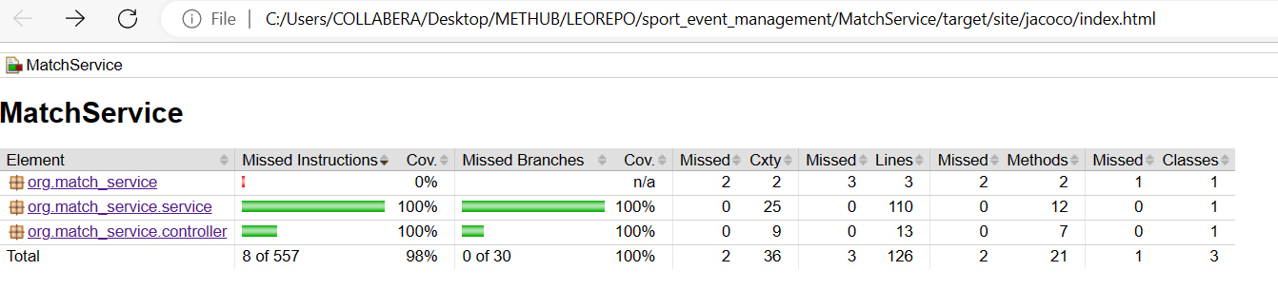
Application Test Report
www.collaberadigital.com

Slide 12
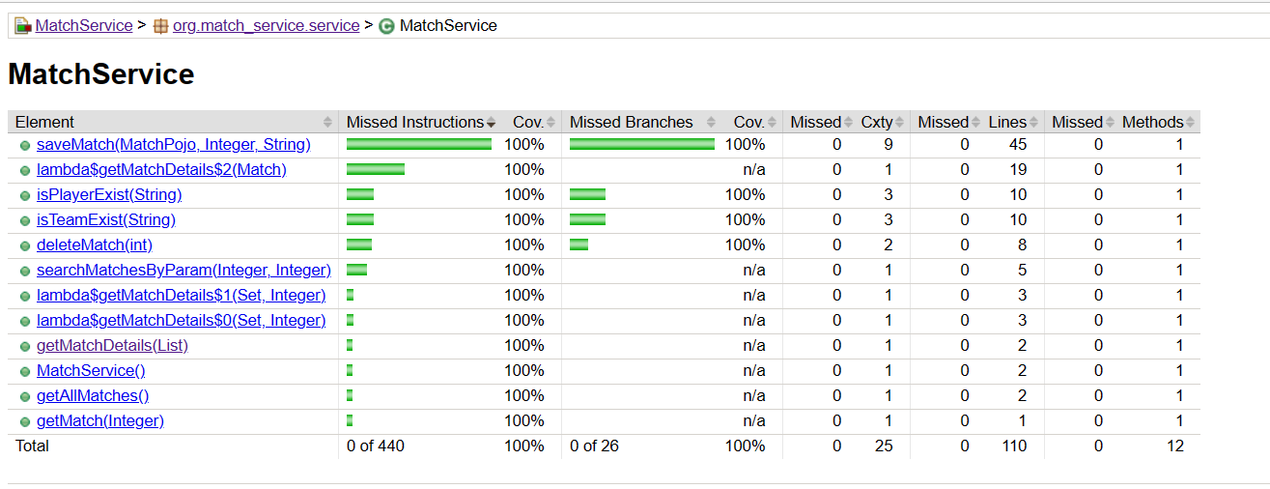
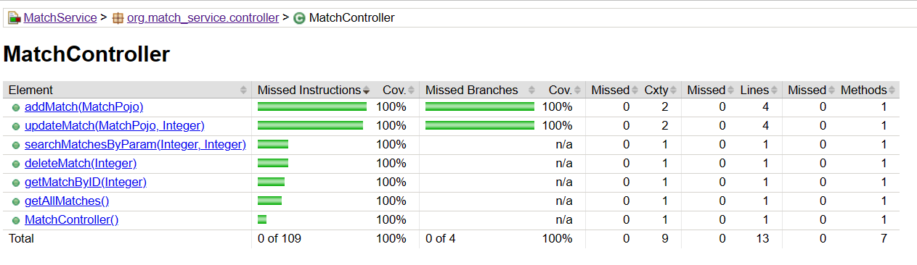
Application Test Report Coverage
www.collaberadigital.com

Slide 13
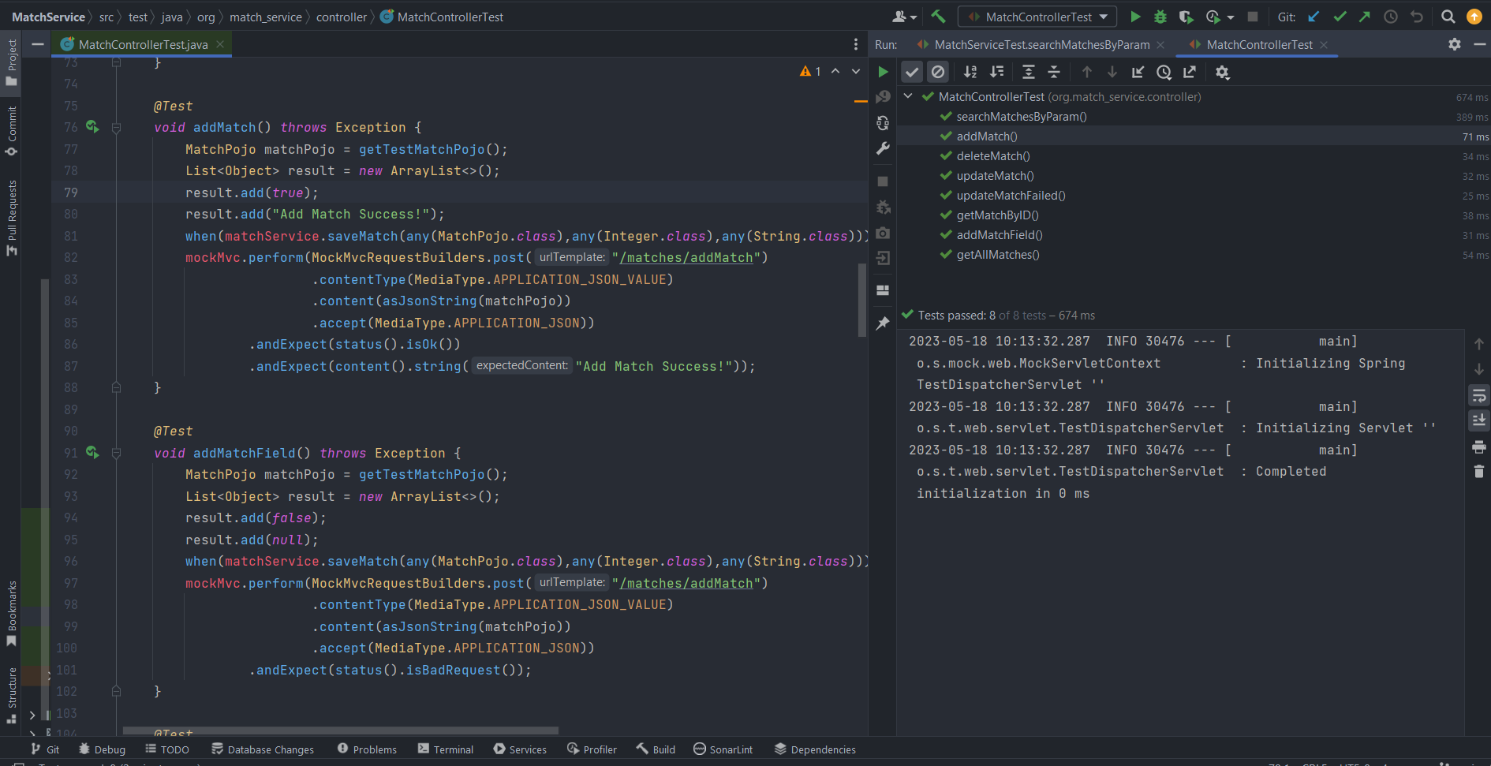
Test Case
www.collaberadigital.com

Slide 14
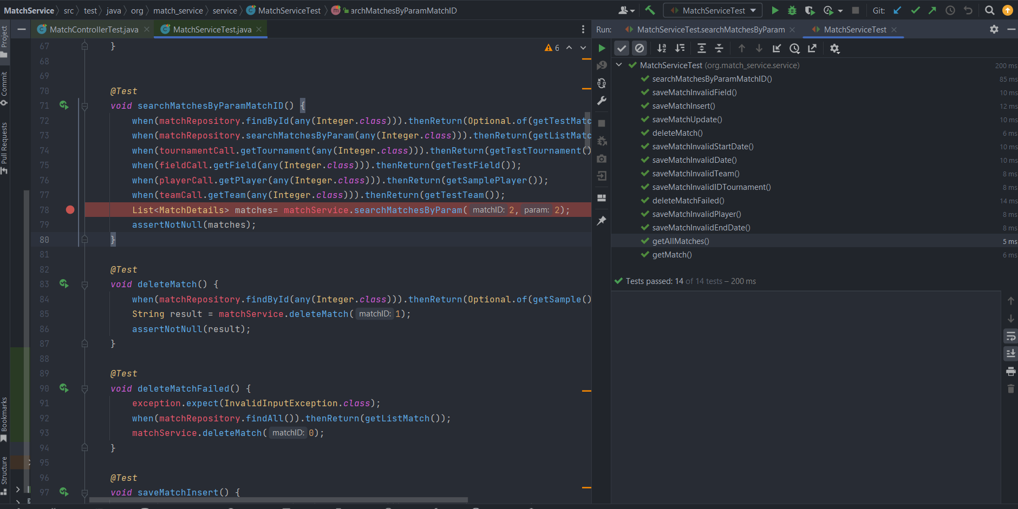
Test Case
www.collaberadigital.com

Slide 15
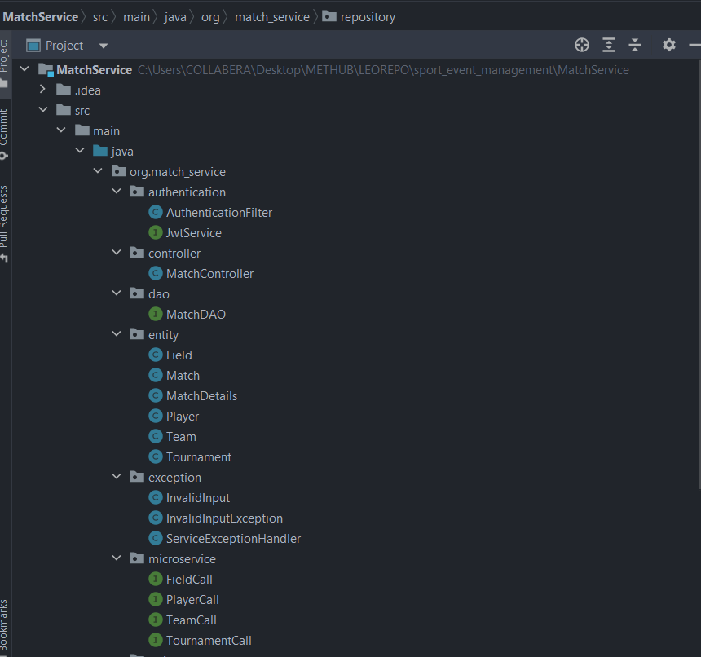
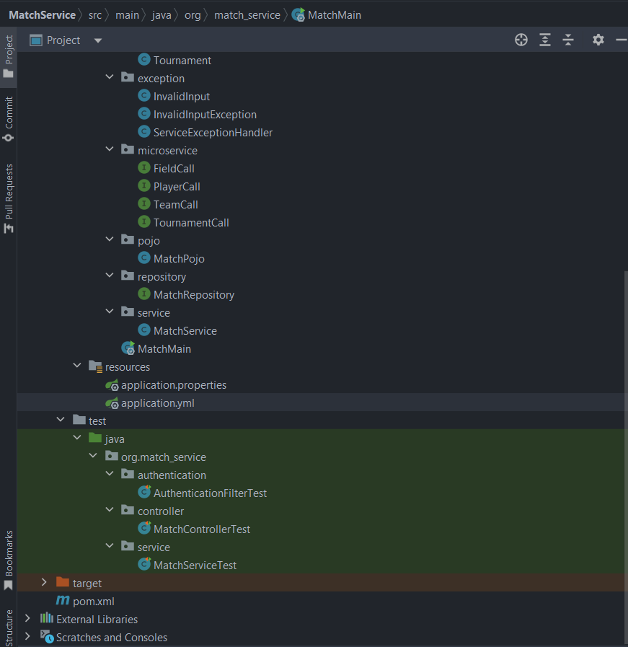
Application Structure
www.collaberadigital.com

Slide 16
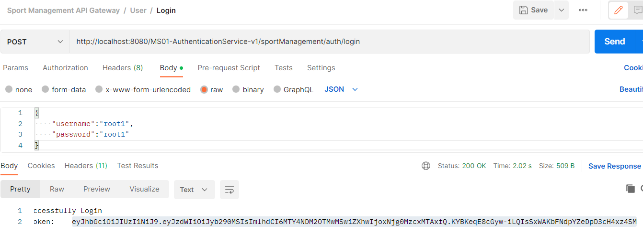
Authentication Service Functions
Log in using token based authentication using JWT

Slide 17
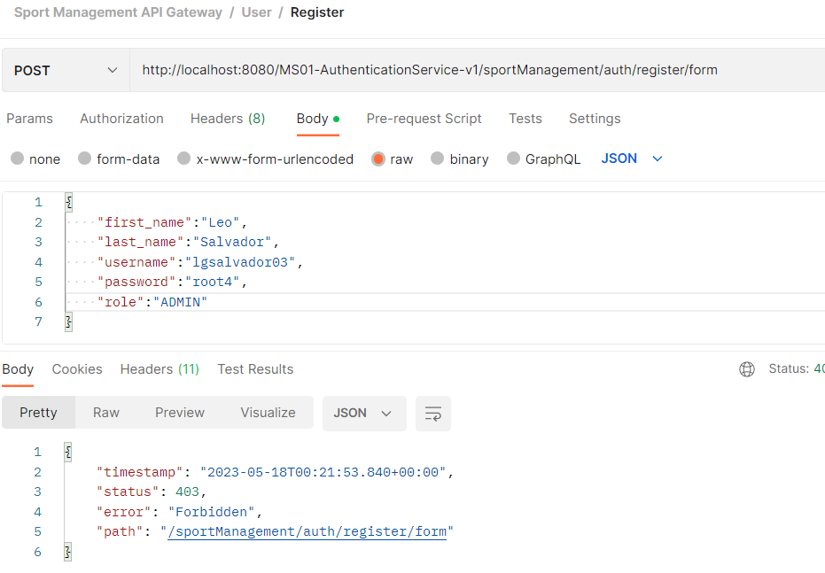
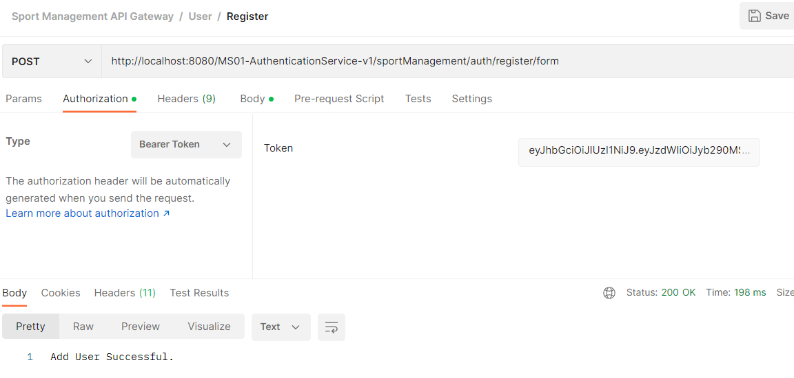
Authentication Service Functions
Use role base authentication
Only admin user can register a user

Slide 18
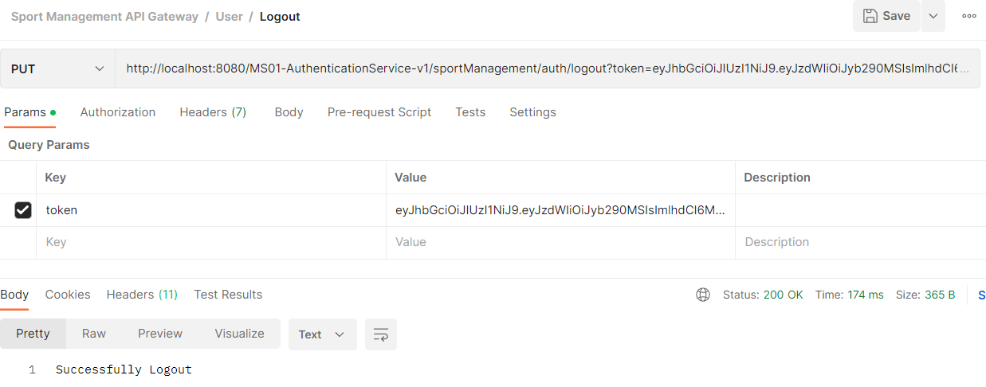
Authentication Service Functions
Logout Function

Slide 19
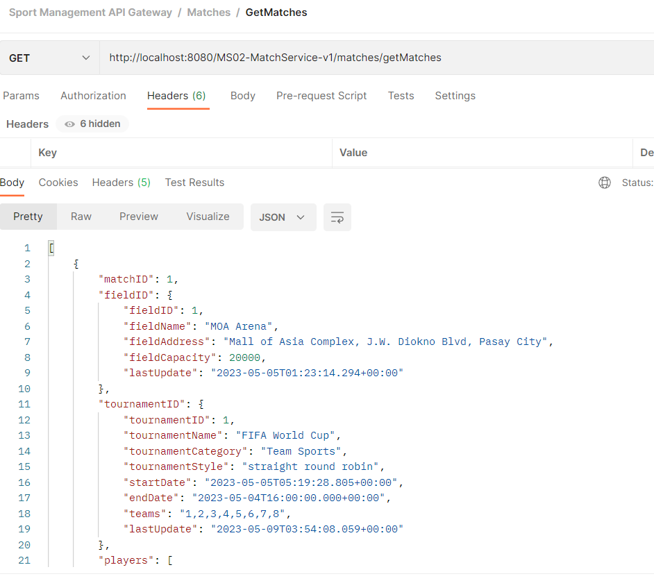
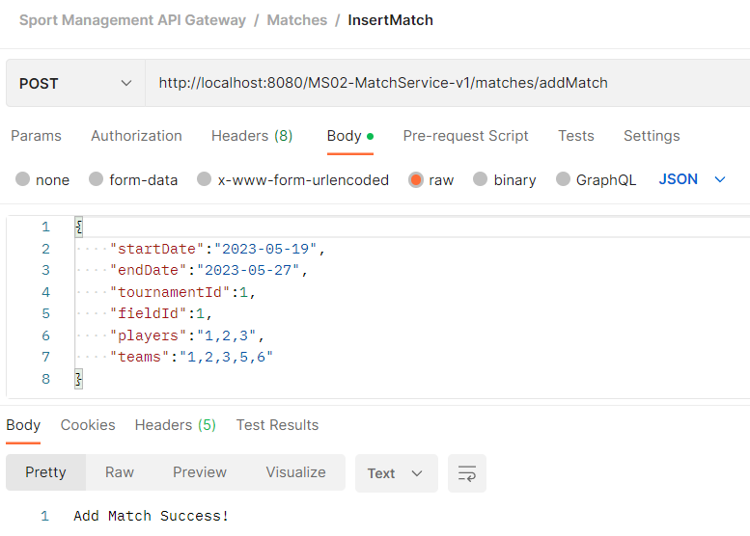
Primary Match Service Functions
CRUD function

Slide 20
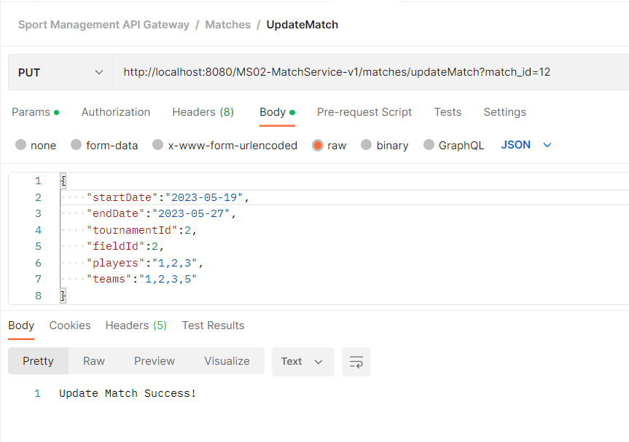
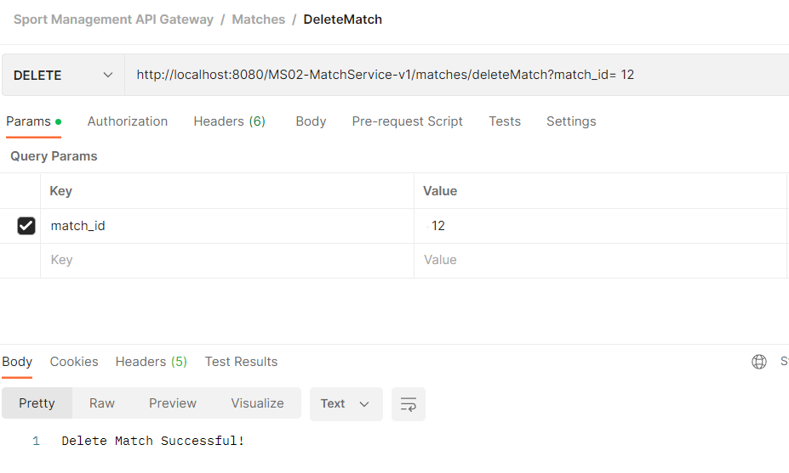
Primary Match Service Functions
CRUD function

Slide 21
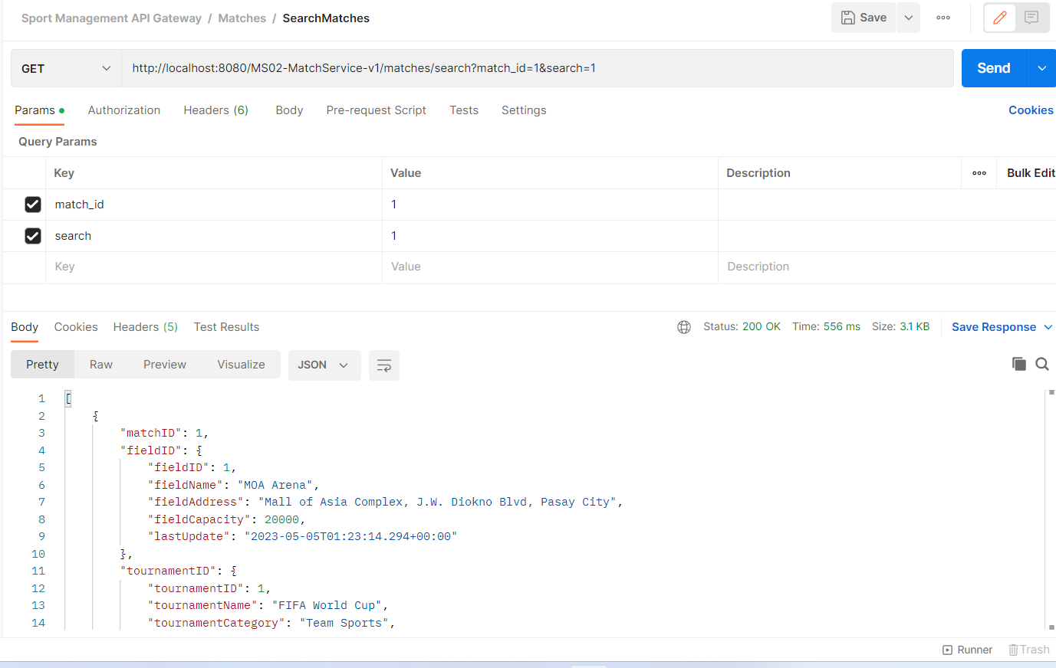
Primary Match Service Functions
Search Function

Slide 22
Program Learning Approach
Practical Hands-on Learning Approach:
Discussed the basics of basic of Java and the simple and efficient way of coding.
Designed microservices based on capstone requirement.
Implemented pair programing.
Prioritized application quality (unit test and code efficiency) as much as the development.
Discussed bugs, fixes and best practices with peer learners using zoom breakout rooms.
Explored different ways to writing code to effectively solve problems.
Made presentations in class and allowed peer learners to ask questions which helped articulate the learning in an effective manner.

Slide 23
Key Takeaways/Learnings from the Program (HTD)
Following best coding practice that more efficient and rectifying code smells using SonarLint and Sonarqube.
Planning, designing, coding and testing and debugging java applications.
Effectively handling of exceptions across all layers of the applications.
Using GIT for version control in the project.
Perform database related operations using JDBC and Hibernate ORM.
Testing REST API end points with Postman
Implementing security using Spring Security Module and JWT Token based authentication.
Working with various spring cloud modules, namely Erueka Server, API Gateway, FeignCleint.
Perform Unit testing on micro services with code coverage.
Applying best practices as a in day-to-day development activities.

Slide 24
Conclusion
A highly practical approach to learning microservices aligned with the real-time project practices has enabled me gain confidence for building enterprise applications using the microservices architecture with best practices.
Delivered and implemented capstone project with microservice structure with JWT based security and authentication service.
Implemented single DB per services to ensure that the services are loosely coupled.
Used Eureka as service register and implement multiple instances per microservices.
Implemented microservice structure with multiple instances and load balancing to ensure high availability, efficiency and, reduce system failure.
Used APIGateway as a programming interface to handles all the endpoints.
Used FeignClient to communicate between microservices.
Rectified all the code smell with the use SonarQube and Sonarlint
Performed test cases with 100% code coverage to ensure the quality of the Service, and Controller Classes using Junit testing and Mockito.
Implemented efficient exception handling.

Slide 25
Thank You
www.collaberadigital.com

